Slide 1

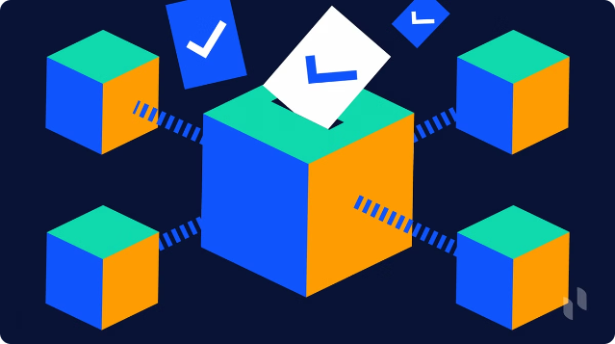

Online Voting System Using Blockchain
Revolutionize online voting with a secure, transparent, and efficient blockchain-based system that enhances trust in the electoral process.

Slide 2

Project Overview
1
Secure Voting
2
Transparent Process
3
Efficient Results
Blockchain's cryptographic algorithms and immutable ledger ensure the integrity of votes.
All transactions are publicly verifiable, increasing trust in the voting system.
Smart contracts automate vote counting and declaration, reducing errors and delays.

Slide 3
Blockchain Technology
Decentralization
Transparency
Immutability
Blockchain is a decentralized, peer-to-peer network, eliminating the need for a central authority.
All transactions are recorded on the blockchain, making the system transparent and auditable.
Once a transaction is recorded, it cannot be altered, ensuring the integrity of the data.

Slide 4

Literature Review
Security Challenges
Existing voting systems are prone to fraud and manipulation.
Blockchain's Potential
Blockchain can address security issues and enhance trust in the voting process.
Previous Implementations
Studying past blockchain-based voting systems and their outcomes.

Slide 5


Key Findings
1
Security
Blockchain's cryptographic algorithms and immutable ledger enhance vote security.
2
Transparency
All transactions are publicly verifiable, increasing trust in the voting process.
3
Efficiency
Smart contracts automate vote counting and result declaration, reducing errors and delays.

Slide 6





Limitations
Scalability
Blockchain networks may face issues handling large volumes of transactions.
Anonymity
Balancing transparency and voter privacy is a challenge.
Regulatory Challenges
Legal and regulatory barriers to adopting blockchain-based voting systems.

Slide 7


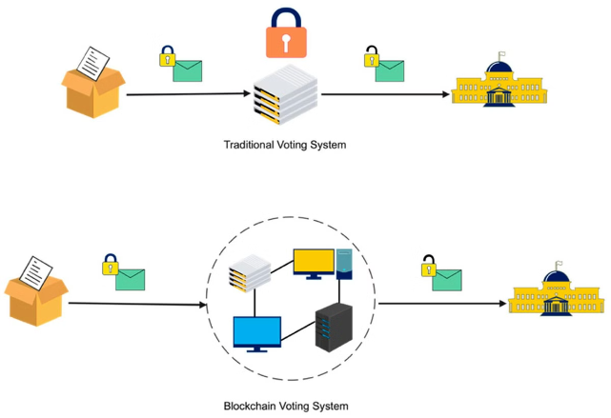


Proposed Solution
Voter Authentication
Ensure only eligible voters can participate.
Secure Voting
Record votes as immutable transactions on the blockchain.
Transparent Results
Publicly verifiable vote counting and real-time result declaration.

Slide 8

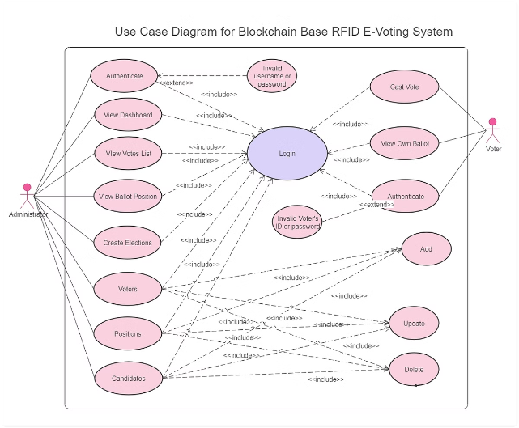
System Architecture
User Interface
Allows voters to register, authenticate, and vote.
Blockchain Network
Records votes as transactions on the immutable ledger.
Smart Contracts
Automate vote counting and result declaration.
Voter Authentication
Ensures only eligible voters can participate.
Vote Counting
Ensures accurate and transparent vote counting.

